Slide 1

Instrumentation and Control
CSE 325
Some books are to be tasted, others to be swallowed, and some few to be chewed and digested
-Franics Bacon
Mehedi Hasan
Lecturer
Computer Science and Engineering(CSE)
Daffodil International University(DIU)

Slide 2
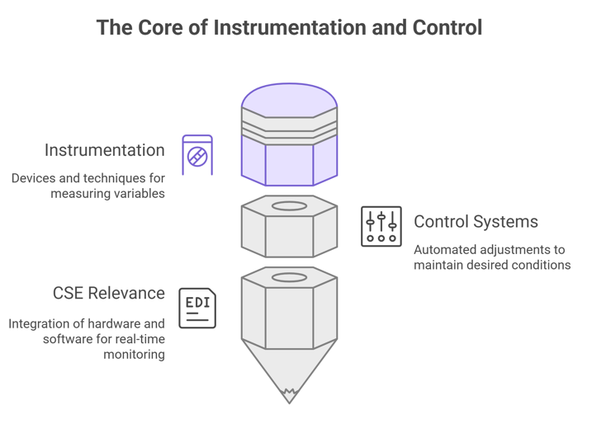
Introduction
Instrumentation and Control in engineering deals with measuring, monitoring, and regulating physical processes. In modern systems, accurate measurement and precise control are essential for automation, safety, and efficiency.
Instrumentation refers to the devices and techniques used to measure variables such as temperature, pressure, flow, and level. These measurements provide the data needed to understand and manage processes.
Control systems use this data to make decision automatically adjusting operations to maintain desired conditions. For example, in industrial automation, sensors measure process variables, and controllers adjust actuators to keep the system stable and optimized.

Slide 3
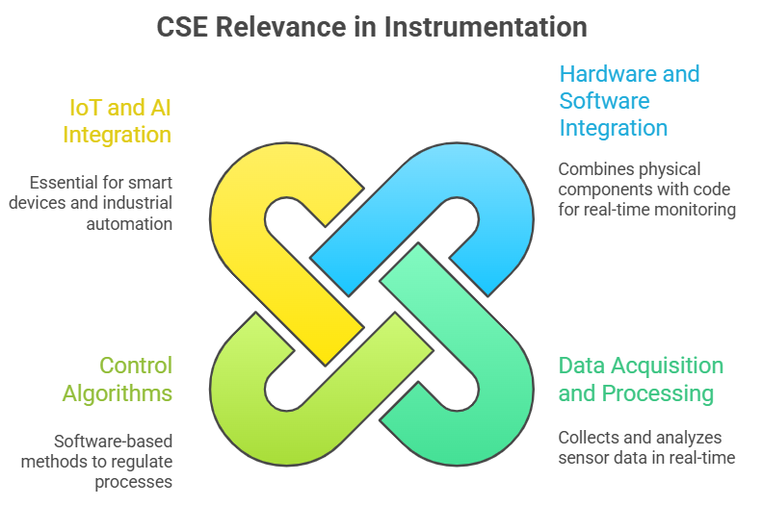
Introduction
For Engineering students, this field is highly relevant because:
It integrates hardware and software for real-time monitoring.
It involves data acquisition, signal processing, and control algorithms.
It forms the backbone of IoT, robotics, and smart systems.
Why It Matters for CSE??
Data Acquisition & Processing: Sensors generate data that must be processed in real-time.
Control Algorithms: Implemented in software to regulate processes.
Integration with IoT & AI: Instrumentation is key for smart devices and industrial automation.

Slide 4
Applications of Measurement Systems
Applications are generally classified into three major classes:
1. Monitoring of processes and operations
2. Control of processes and operations
3. Experimental engineering analysis
1. Monitoring of processes and operations
- measuring instrument is used to keep track of some quantity.
- e.g. thermometer, barometer, radar used by weather department
- e.g. water, gas, electric meters in home

Slide 5
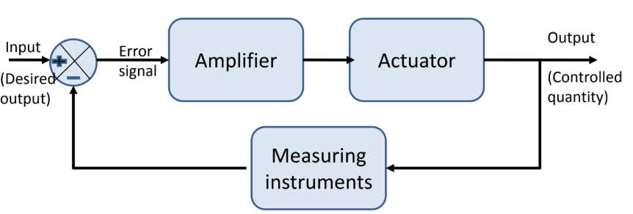
Applications of Measurement Systems
2. Control of processes and operations
- The most important class of measurement application
(automatic control systems)
- Feedback control system:

Slide 6
Applications of Measurement Systems
3. Experimental engineering analysis
- Part of engineering design, development and research
- two basic ways of solving engineering problems: Theory and
Experimentation
Most problems require blend of theory and experiment
- For example,
• Experimental validation of theoretical prediction/simulation
• Formulation of empirical equations

Slide 7
Functional Elements of a Measurement System
Generally, measurement systems contain three functional elements:
1. Primary sensing element
2. Signal conditioning element and
3. Data presentation element
Each element is made up of a distinct component or a group of components which perform the required function
1. Primary sensing element
Variously known as detector/sensor or transducer
2. Signal conditioning element
- sometimes, the raw signal output from the sensor is not suited to the desired performance of the system
- For example: filtering noise, amplifying signal and A/D conversion
- Many instruments do not need any signal conditioning element

Slide 8
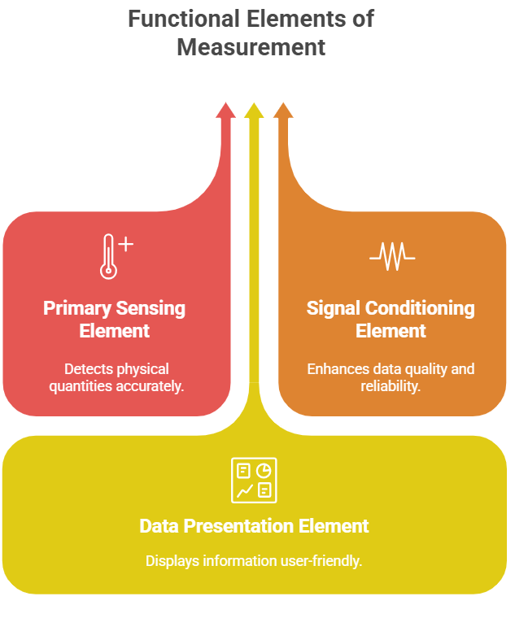
Functional Elements of a Measurement System
3. Data presentation element
- The quantity under measurement has to be conveyed to a personnel or to the system for monitoring, control, or analyses purposes.
- The data conveyed must be intelligible to the
personnel/system
manual monitoring: visual display (LED/LCD, pointer etc)
recording: magnetic tape, printers, computer etc
- control and analysis: computer, microcontroller

Slide 9
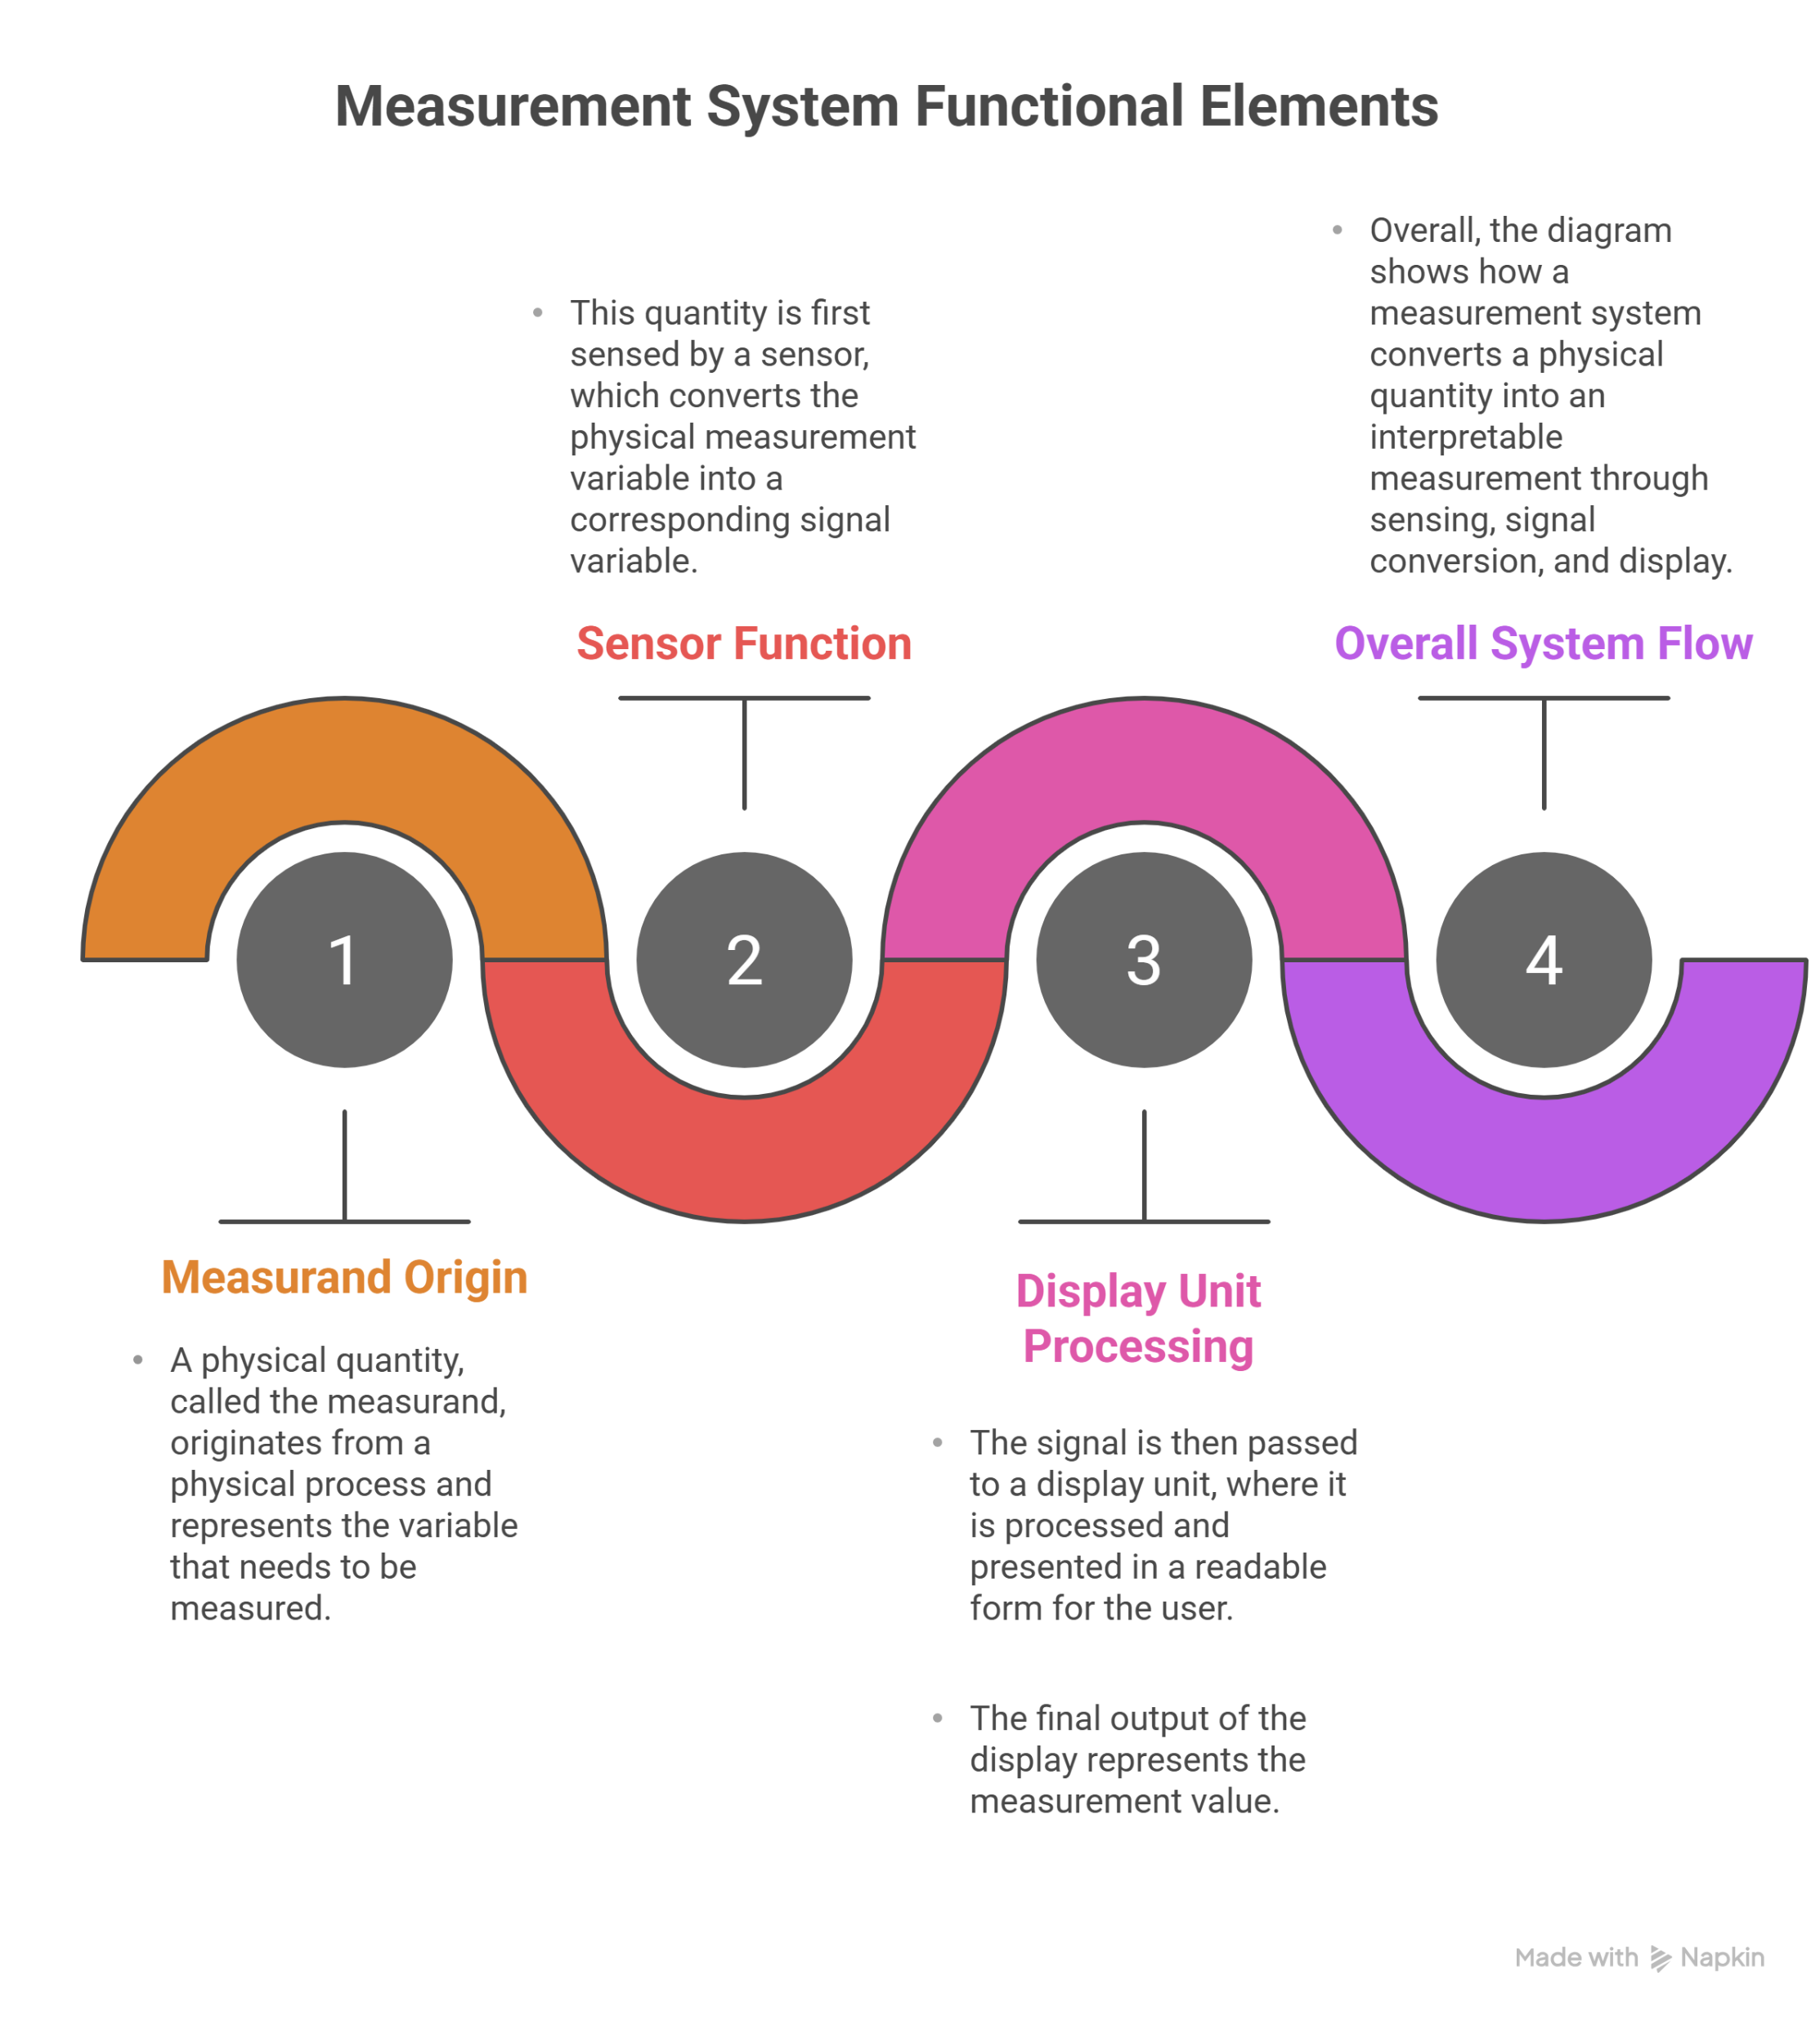
Functional Elements of a Measurement System

Slide 10
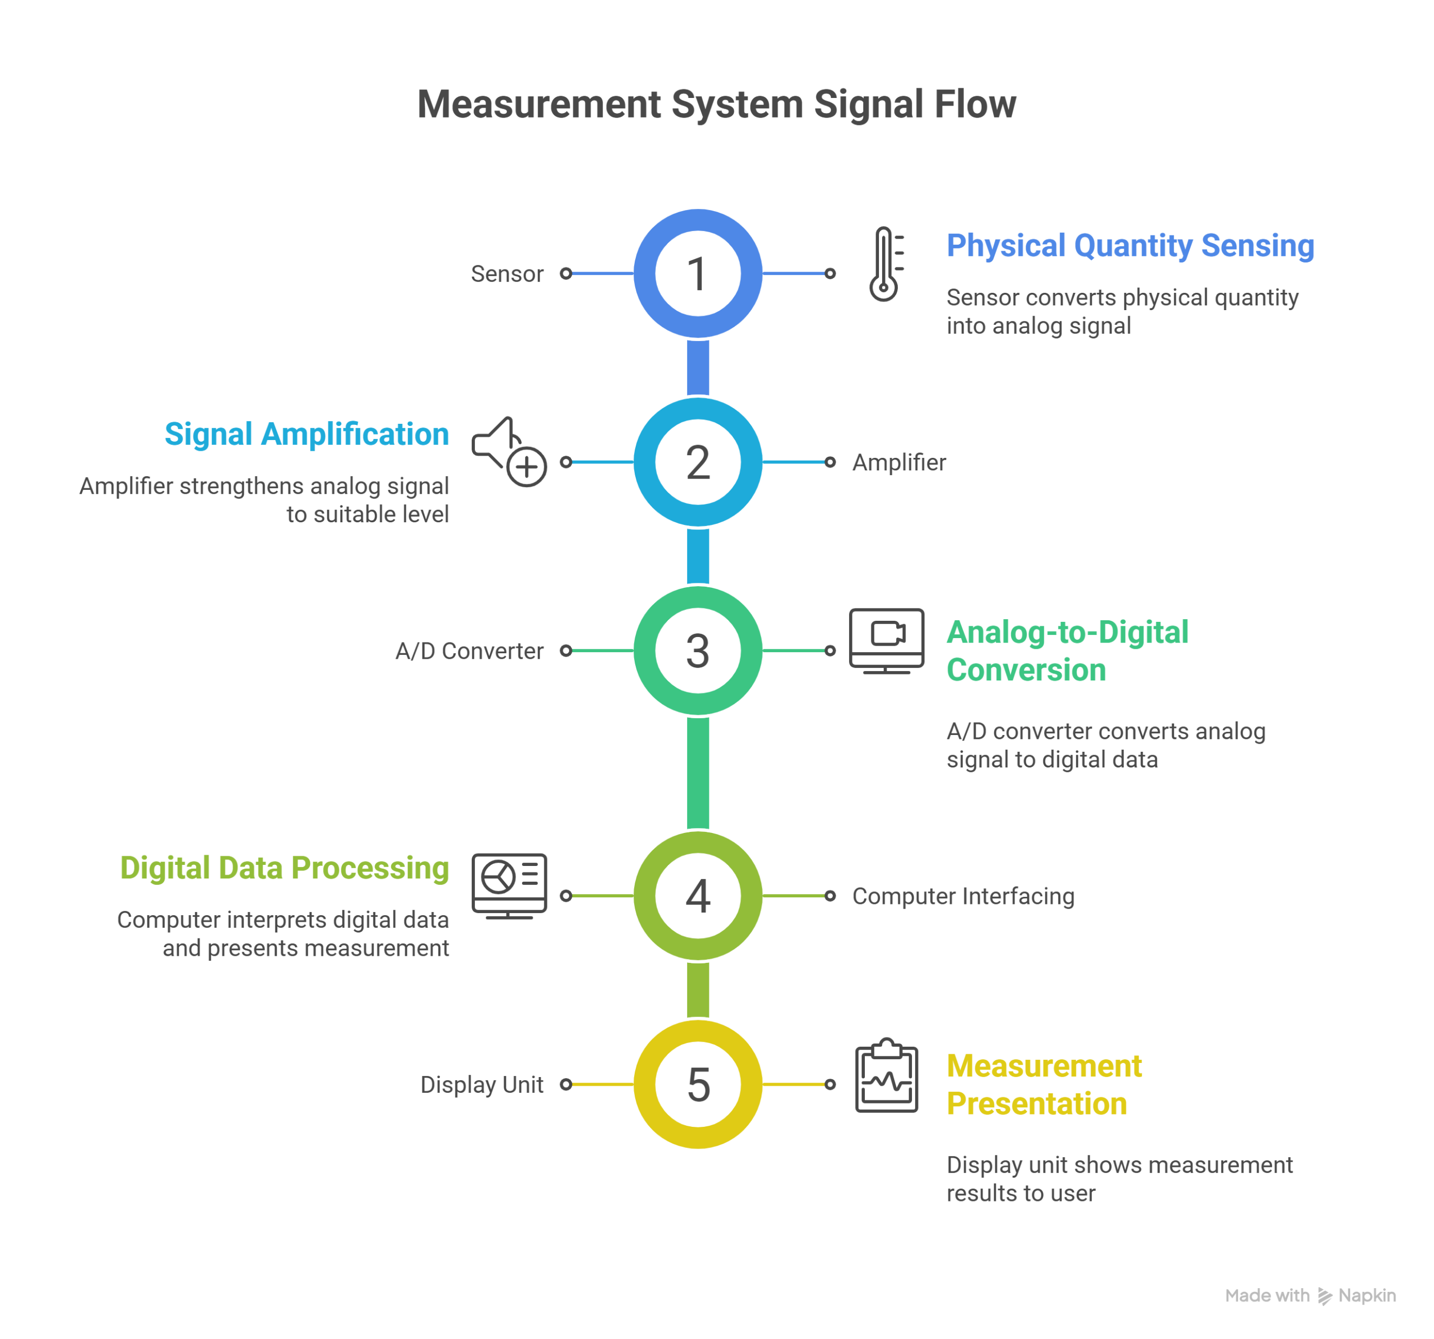
Functional Elements of a Measurement System

Slide 11
Important Terminologies
Active Sensors
Active sensors send out their own energy (like a signal or wave) toward an object and then measure the energy that comes back after hitting it.
They work at day or night even in cloudy or dark conditions. Common in radar and laser systems
Example: Radar sends radio waves to the Earth and measures the reflected waves to detect objects or land features.
Passive Sensors
Passive sensors do not send out energy. They only detect natural energy coming from objects, usually sunlight reflected or heat emitted.
Very common in cameras and satellites
Example: A satellite camera that captures images using sunlight reflected from Earth.

Slide 12
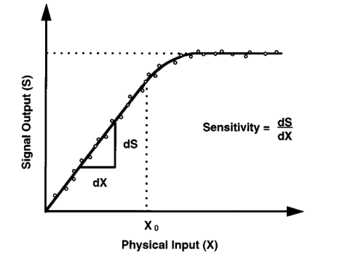
Important Terminologies
Calibration: The relationship between the physical measurement variable (input) and the signal variable (output) for a specific sensor is known as the calibration of the sensor. Typically, a sensor (or an entire instrument system) is calibrated by providing a known physical input to the system and recording the output.
Calibration Curve:
Sensitivity: Ratio of output signal or response of the instrument to
a change of input or measured variable

Slide 13
Types of Errors
Gross errors: largely human errors, e.g. misreading, incorrect adjustment and improper application of instruments.
Systematic errors (bias): shortcomings of the instruments, e.g.effects of environment (temperature, humidity etc) on the instrument, change in instrument response due to aging.
Way to reduce:
- Use of compensation can reduce/remove some systematic error
- periodic recalibration can prevent systematic error
Random error (noise): caused by the noise introduced during the measurement process and random variation of input itself
Way to reduce:
- taking a large number of readings and averaging them can reduce the effect of noise

Slide 14
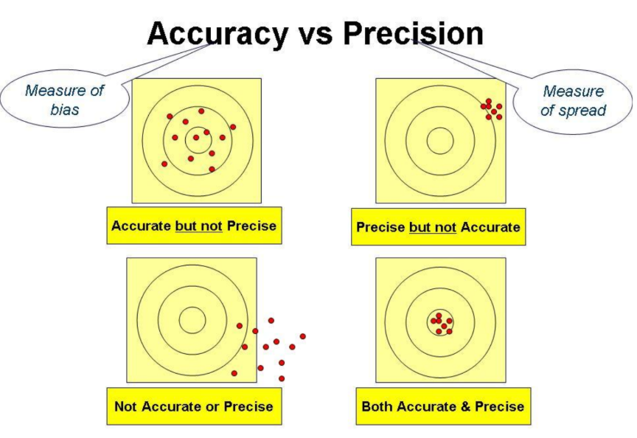
Accuracy Vs Precision
Accuracy: Closeness with which an instrument reading approaches the true value of the variable.
- It is affected by the systematic error (bias) of the instrument
= true value – statistical mean of the measurements
Precision: A measure of the reproducibility (or spread) of the measurements. It is a measure of the degree to which successive measurements differ from one another.
- It is affected by the random error (noise) of the instrument
= standard deviation (σ) of the measurement

